Slide 1
Analysis of Irorun Customer Issues
1st June, 2022 - 30th November, 2022.

Slide 2
Introduction
Irorun is a digital lending application that offers microloan to eligible users. Lending is the core aspect of a loan company. Therefore, this analysis tends to evaluate the issues faced by the customers.
This analysis give answers to four (4) crucial questions:
What are the top 10 issues raised by customers statistically?
What are the top 2 days in a week where issues are raised?
What are the top 5 issues that take the longest to resolve?
What are the top 5 issues faced by the Customer Support team?
The dataset used for this analysis was Freshdesk tickets created by customers from 1st June to 30th November, 2022. The dataset was exported to Excel for cleaning before it was finally moved to Tableau for further analysis.

Slide 3
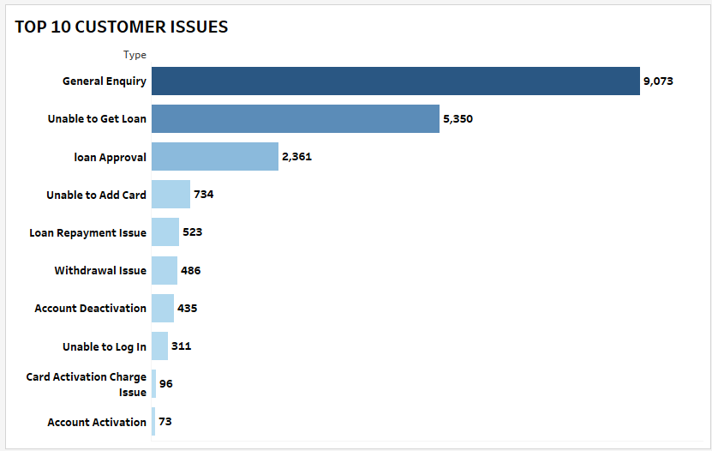
Top 10 Issues Raised By Customers
The issues raised by the customers were filtered to the top 10. From the analysis, it is obvious that “General Enquiry” had the highest issues followed by “Unable to Get Loan” with “Account Activation” being the least. “General Enquiry” is a combination of different issues that are not in match with the other types and this is the reason why it had the highest number of issues.
They are mostly inquiries by customers about how to get a loan in Irorun and its interest rates.

Slide 4
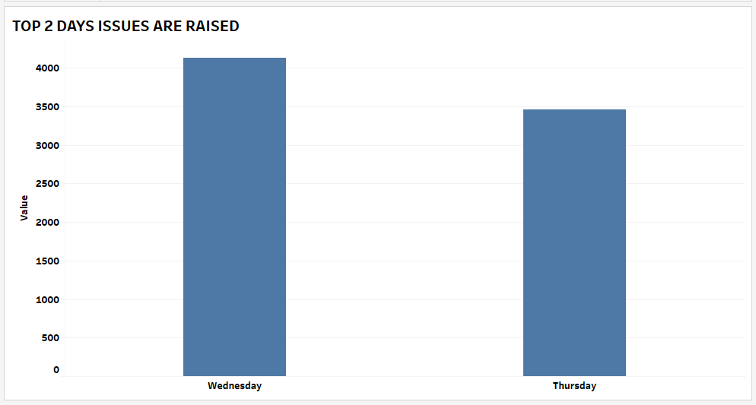
Top 2 Days Issues Are Raised
From the analysis, it was found that “Wednesday” and “Thursday” had the highest issues raised. From our research, we noticed the increase in these days was as a result of “Push mail notifications” to users and this must have led to the influx of tickets coming in for those days.

Slide 5
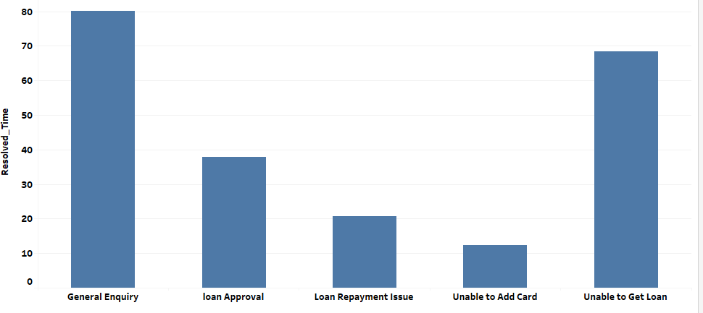
Top 5 Issues that take the Longest to Resolve
In achieving this, I made a calculated field on tableau while taking into consideration the difference between “created time” and “resolved time” to get the actual time it took to resolve a ticket.
From the analysis, it was extracted that “General Enquiry” topped the list with “Unable to Get Loan” following closely and it took both issues about 70-80 hours maximum to resolve.
The causes will be explained in details in the next section. However, it is worthy of note that when a customer responds to a resolved chat it becomes open which must have led to a much longer time.

Slide 6
A Review of the Issues Mentioned
ISSUES | CAUSES | RESOLUTIONS
Unable to Get Loan | Users are ineligible. This is due to loan delinquency by the user or they are applying for a Loan product they are ineligible for (first-time user applying for Easy Credit Loyalty). The user did not add his Bank card. Pause on loan approval/disbursement | Remove the defaulters from the Push Mail Notifications since they are ineligible for a loan. The system should prompt the user to add his/her card - this issue has been resolved. Notifications should be sent across to eligible users.

Slide 7
Loan Approval | First-time users are required to call agents for their final stage of loan application. | Customer agents should be assigned to receiving and calling new borrowers.
Unable to Add Card | Users tried to add cards that might have failed one of the requirements. For instance, verve or virtual cards. Users added a card that met all the requirements but still fails to reflect. | The App/web should bring up a “we do not accept Verve//virtual cards”. If possible, it should identify the particular card-Kuda, Opay, etc. This is a technical issue that should be resolved immediately by the Engineers.

Slide 8
Loan Repayment Issue | Those that collected Migo loans are not aware of the payment channel so they fund their Irorun wallets. Users fund their wallet without initiating payment. Users initiate payment but it was unsuccessful. | The Migo loan SMS notification should contain a direct link to repaying the loan. Technical issue - the system forgot to update the loan schedule. Embed videos in the web and App to show users how to repay their loans.
Withdrawal Issue | Pending transactions | Payment gateway is yet to send the correct transaction status to nuntius/Pecunia.

Slide 9
 | Users make withdrawal to virtual accounts or account not linked to their profile. | The App/web should bring up a “you cannot make transfers to virtual accounts or accounts not linked to your profile”. In addition, it would be better the system does not debit the wallet if transaction was not successful.
Account Deactivation | Users request for their account to be deleted. The user was blacklisted. | Users should be notified when they are deactivated.

Slide 10
Unable to Log in | This is usually caused by service downtime. Some users must have forgotten their password and others are deactivated users. | After requesting users to uninstall and install the App, the issue becomes resolved. We send them canned response on how to retrieve their password.
Card Activation Charge | Some users are debited without successfully linking their cards. | They shouldn’t be debited if the card does not meet the requirement.

Slide 11
Account Activation | Users requesting that their accounts be restored. | Find out the reason why the account was deactivated. If possible, include a “restore account” on the App interface.

Slide 12
Conclusion
Based on the analysis of customer complaints, I have identified several issues that appear to be contributing to customer dissatisfactions and the major issue of concern is “unable to get loan”. Irorun is a platform that is known for giving out loans. If the customer cease to be ineligible, then he/she has no business with Irorun. Therefore, I suggest they are removed from the Push mail notifications. Then there has been few cases recorded on “could not get data from Mono” these past weeks as a reason why a user is ineligible for a loan.
Recently, there has been a rise on Migo loans disbursed but wallets not funded and few cases of Irorun loans that are running but wallet not funded especially on the 5th and 28th of December, 2022 respectively. I think a lasting solution should be provided to solve this issue. No user will want to be harrassed by SMS notifications when money was never received on their ends.
Lastly, I would recommend there is a shift for those in charge of transactions so that users can get their money during weekends, or a notification mail informing users that we do not work on transactions on weekends. These and many other recommendations will help reduce the number of customers that are on Desk//Chats complaining and rendering abuses on the Customer Support teams. Thank you.

